Slide 1

UTest
UTest
01

Slide 2

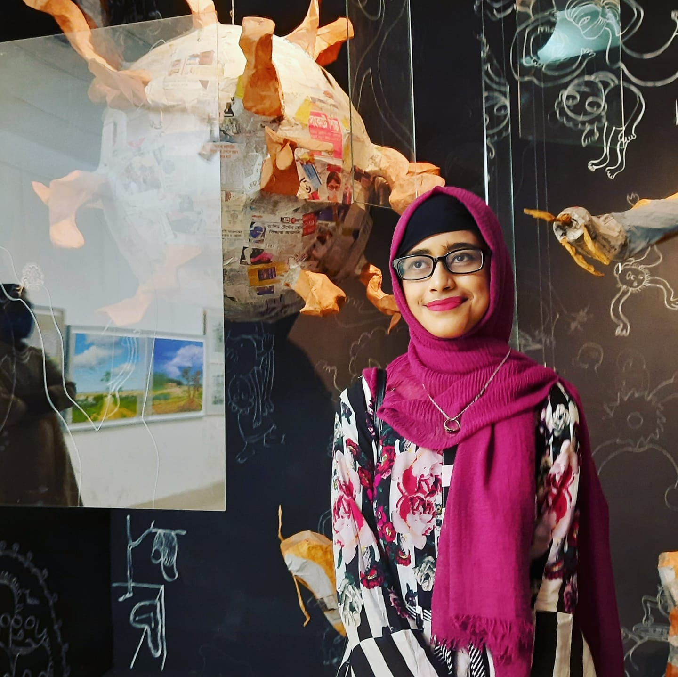

.
Team Members
Ifrat Jahan Chowdhury
Fariya Islam
Md. Fahim Rahman
ID:18.02.04.003
ID:18.02.04.007
ID: 18.02.04.028

Slide 3
What is UTest?
Utest is an online-based exam system where HSC and University Admission candidates can perform exams according to their needs.
It is focused on HSC candidates and University admission candidates.
To judge their talent, the students have to sit on exam. They can do their exam online without going outside utilizing their time properly.

Slide 4
“Success is not final, failure is not fatal:
it is the courage to continue that counts.” - Winston Churchill, former Prime Minister of the United Kingdom

Slide 5

Practice makes a man perfect
Students will have accounts, and rankings, based on their scores. They can set their exam duration, allow negative marking, select a number of questions and related topics. The topics will cover subjects like Bangla, English, Physics, Chemistry, Math etc.

Slide 6
Goals of UTest
By using Internet,students can give exams anywhere at any time.
They can test their skills without going to any coachings or spending huge amount of money.
They can find solutions without waiting for long time.

Slide 7
Our key features
Student Account Students have their own account. They can login via email & password
Exam Flexibility Can create mock test, allow minus marking, tune exam duration, number of questions
Live Exam Students can participate in live exams
Reward Points Get reward points on their exam score
Re-exam Students can re-exam on their mistakes
Performance Analysis They can see their position in the leaderboard, analyse their performance via charts

Slide 8
User flow
LOGIN
DASHBOARD
MOCK TEST
PERFORMANCE ANALYSIS
User will login with their email and password
See their dashboard
User can do exams on their need
User can see performance analysis charts

Slide 9
13,99,690
candidates are expected to sit for the HSC exam
of 2020-2021 session

Slide 10
5 Years Road Map
Users
5,00 ,000
4,00,000
2,50,000
1,00,000
The more users join in our system,
the more we will grow.
50,000
0
2022
2023
2024
2025
2026
Years

Slide 11
S
W
O
T
STRENGTHS
WEAKNESSES
OPPORTUNITIES
THREATS
Education to everywhere
Easy access
Best quality questions
New in the market
Question resources inadequate
Shortage of funding
More students can reach out
Online based education
Tutorials can be provided
Slow Internet
Make aware of online exam system

Slide 12
Gantt Chart
Tasks
Dec
Jan
Feb
March
April
Project Architecture Design
Project Development Planning
Project Proposal
Front-end Design
Website Back-end Development
Testing and Debugging
Deployment

Slide 13







Technologies that will be used in our Website
HTML for
Frontend
CSS for
Frontend Design
Javascript for Frontend
C# language for website backend
.NET framework for Backend
Visual Studio 2022
MySQL as
Database

Slide 14

Database

Slide 15
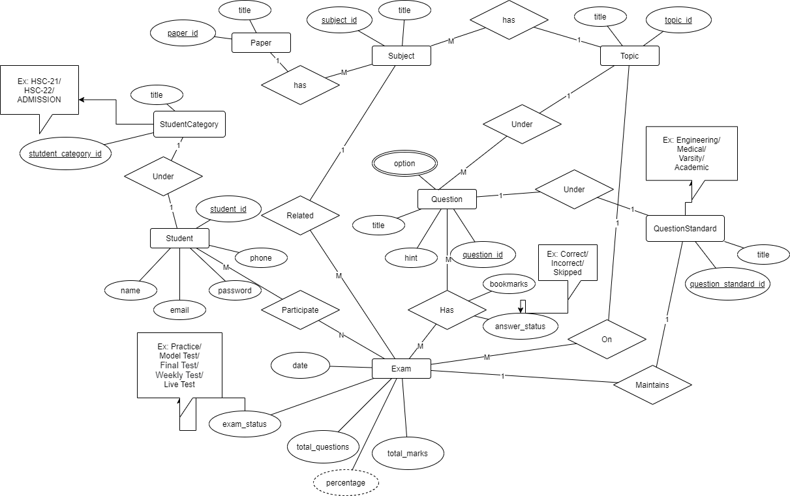
ER Diagram

Slide 16
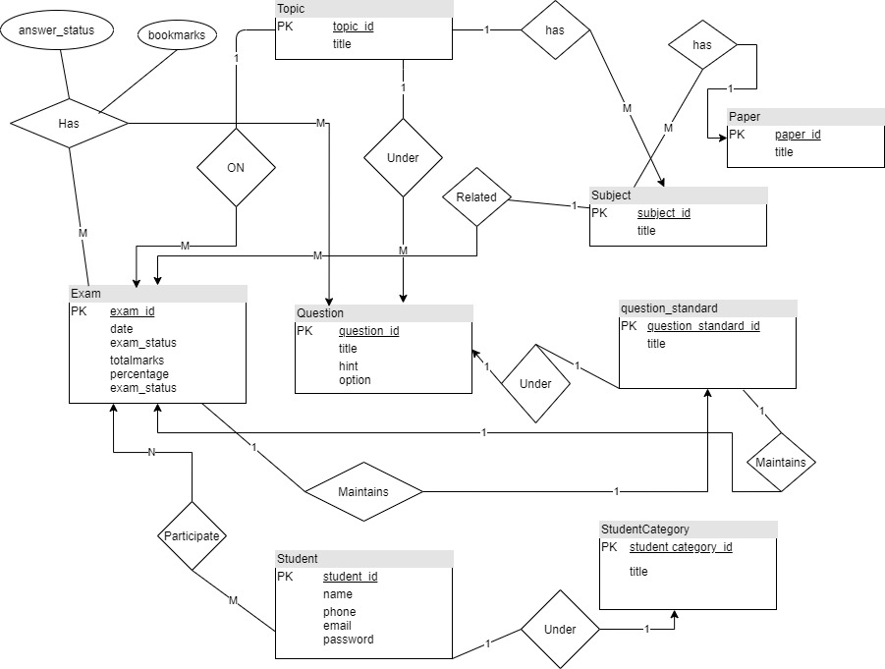
ER Diagram
(in different format)

Slide 17
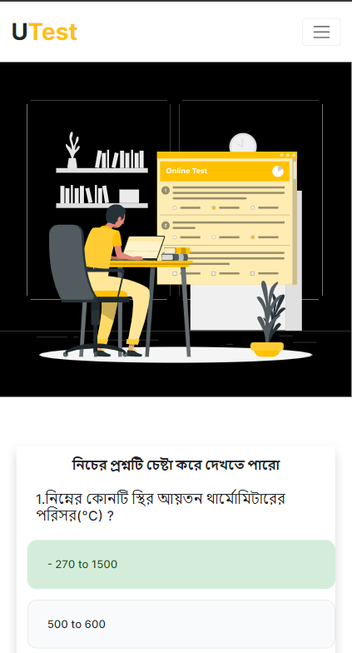
Browse UTest
from your favourite browser
Anyone can test themselves from anywhere with internet access only

Slide 18
Thank you!

